Slide 1
Shockingly Moral
Janik and Owen

Slide 2

we dont like theft

Slide 3

to demote thieves from stealing,
we’ll shock the $h!t out of them
we have tested it for safety

Slide 4
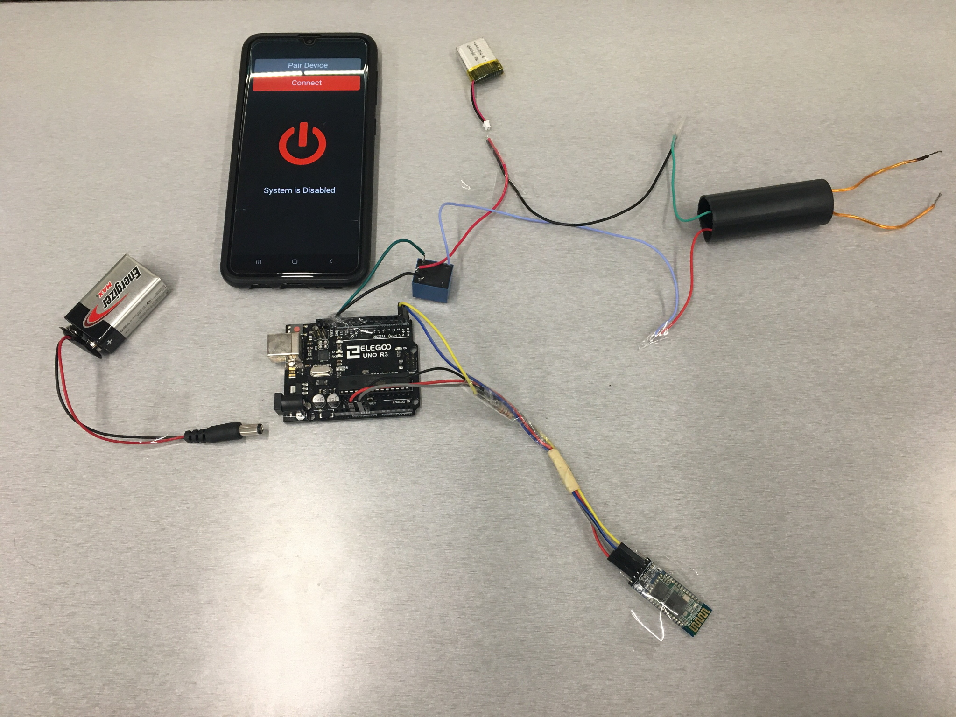
Taser LiPO Battery
3.7v to 4000v
transformer
Arduino Uno
9v Battery
Bluetooth Module

Slide 5
Android App
Taser LiPO Battery
3.7v to 4000v
transformer
Arduino Uno
9v Battery
Bluetooth Module

Slide 6

lets see how other hackers reacted

Slide 7
live demo?
y’all wanna try it?

Slide 8
questions?
(yes it is safe.)

